Slide 1


MEDICAL INVENTORY OPTIMIZATION
Pulagam.Hema Sri

Slide 2
Contents
Business Objective
Business Constraints
Project Architecture
Data Collection
Exploratory Data Analysis
Data Visualization
Notes:
Change

Slide 3
Business Problem
The increasing bounce rate in medical inventory is adversely affecting patient satisfaction.
Increased bounce rates pose challenges to maintaining an efficient and patient-centric healthcare environment.
The rising bounce rate is leading to negative consequences, such as delayed patient care, increased waiting times and potential disruptions in medical services.
Delayed access to necessary medical supplies can have adverse effects on both patient outcomes and overall satisfaction.
The overarching business problem is the need to address and minimize the bounce rate in the medical inventory system to enhance patient satisfaction and streamline healthcare operations.

Slide 4
Project Overview and Scope
The Medical Inventory Optimization Project in healthcare tackles a critical issue: a rising bounce rate leading to patient dissatisfaction.
The primary objective is to minimize bounce rates and align healthcare services with patient expectations.
A key constraint involves reducing inventory costs, emphasizing efficient resource management.
Success hinges on achieving a 30% reduction in bounce rates, indicating heightened patient satisfaction, followed by a revenue increase of at least 20 lacs INR.
The initiative aims to enhance patient experiences, optimize inventory processes, and elevate financial performance for the healthcare facility.

Slide 5
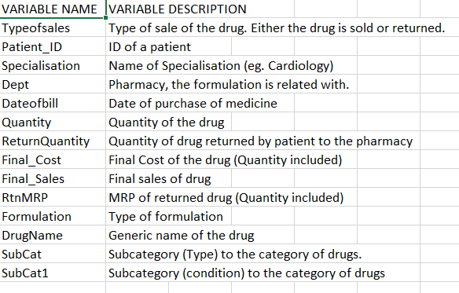
Data Dictionary

Slide 6
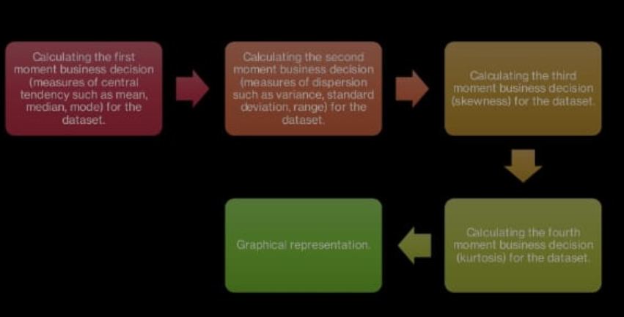
Exploratory Data Analysis [EDA]
Statistical Insights
Business Insights
22.85% of customers did not get the medicines they needed, which could lead to dissatisfaction.
The subcategory "INJECTIONS" has the highest count of returned drug names with 98 occurrences, followed by the subcategory "TABLETS & CAPSULES" with 63 occurrences, indicating a potential issue with customer satisfaction.
The Formulation "Form1" appears to be significantly more prevalent in Department1 compared to other departments
.
Notes:
EDA is used for seeing what the data can tell us before the modeling task.
Change

Slide 7
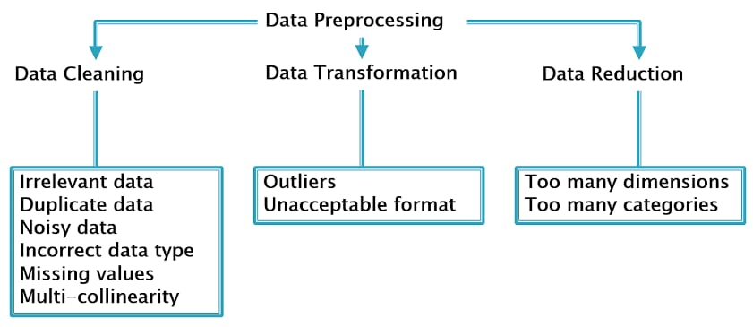
Data Preprocessing
Notes:
Keep observations

Slide 8
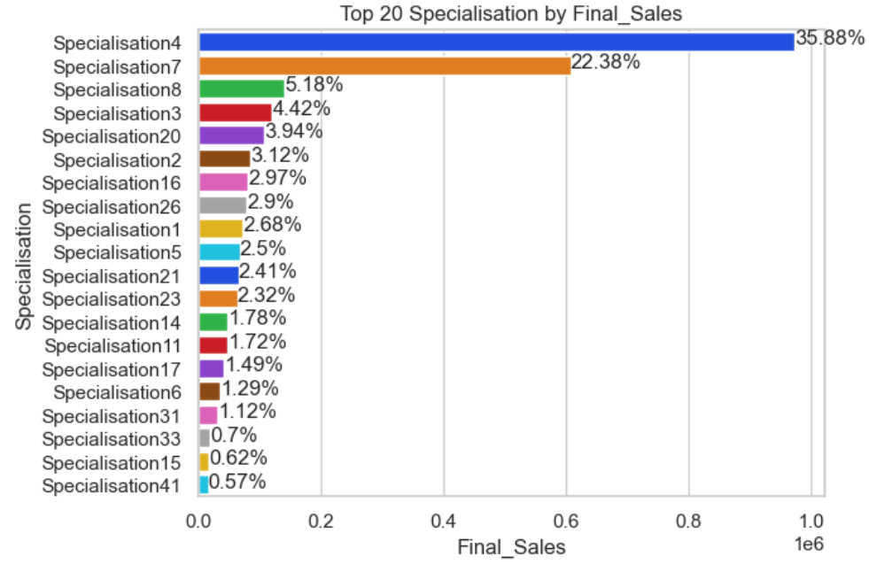
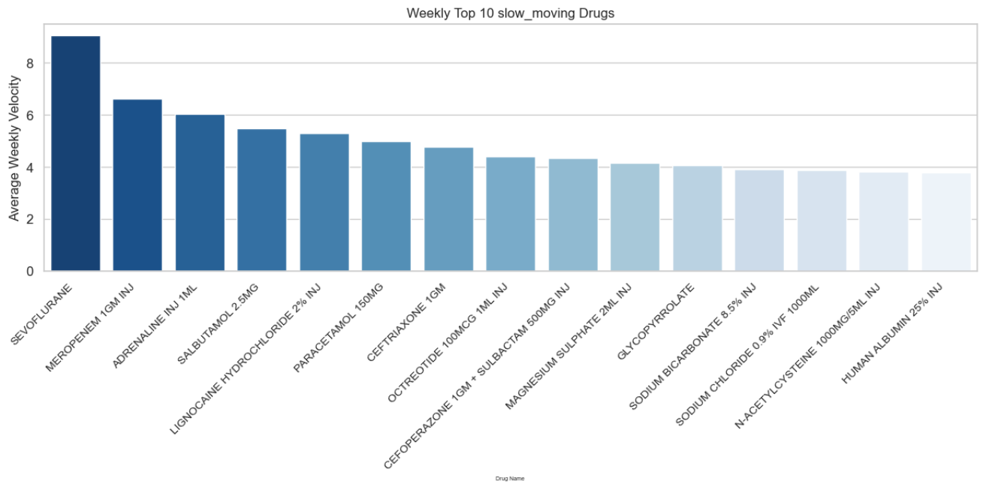
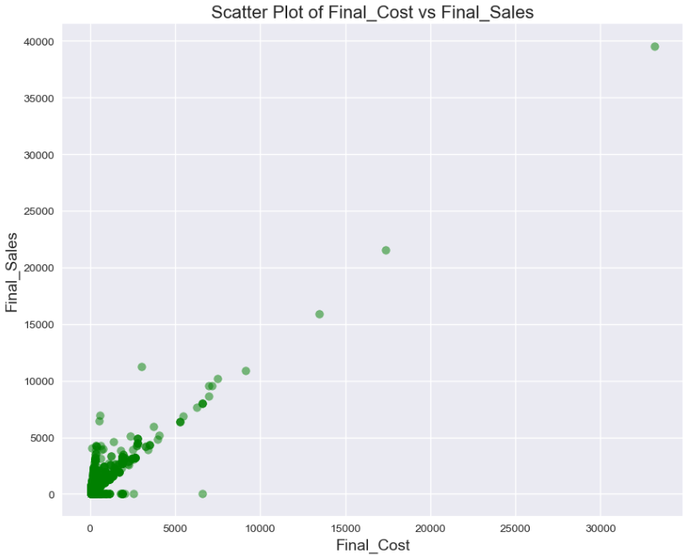
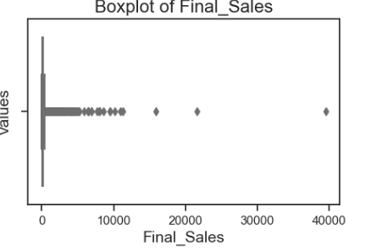
Data Visualization
Notes:
Add graphical

Slide 9


